Slide 1
I400 – Application Development in Java
Lab 4

Slide 2
Today
Debugging in Eclipse
Launching the Debugger
Debug & Java Perspectives
Breakpoints
Stepping Commands

Slide 3
Code Debugging
Debugging: Process of locating and removing bugs, errors and abnormalities from programs we write.
Eclipse IDE provides debugging tools to help developers debug effectively and efficiently.
Big Question: How do we use the built-in debugger in Eclipse?

Slide 4
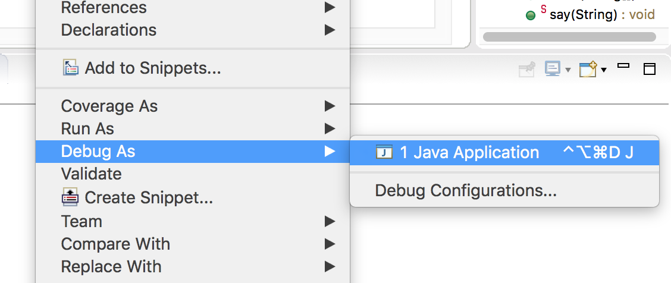
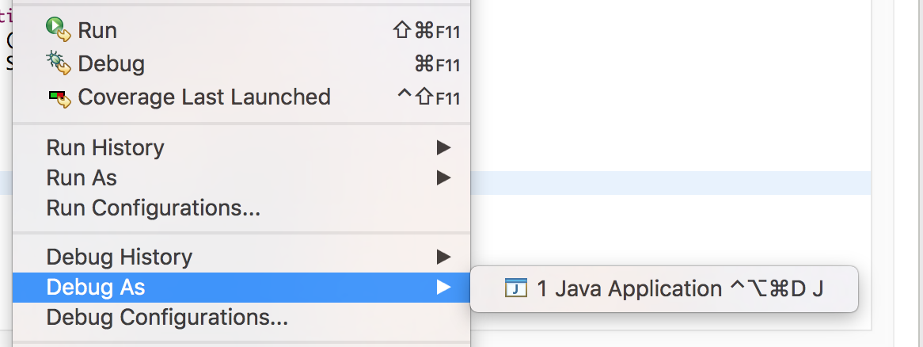
Launching the Debugger
Option 1: Right Click on code editor->Debug As-> Java Application
Option 2: Alt+Shift+D,J
Option 3: Menu bar Run->Debug As-> Java Application or Run-> Debug
Debug Launcher

Slide 5
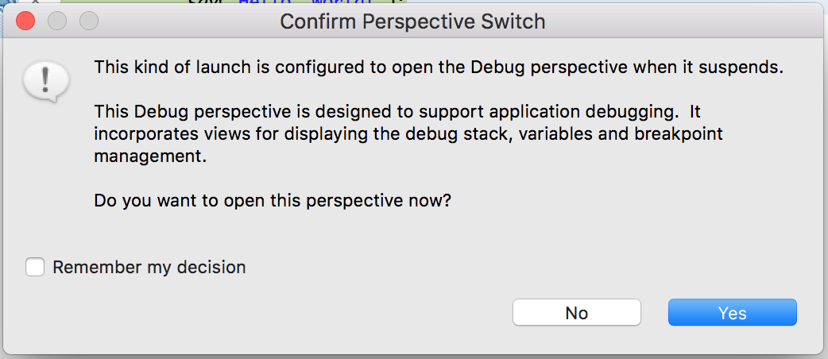
Debug Perspective
When the Debugger is launched Eclipse switches to Debug Perspective.
Check here
Click Yes

Slide 6
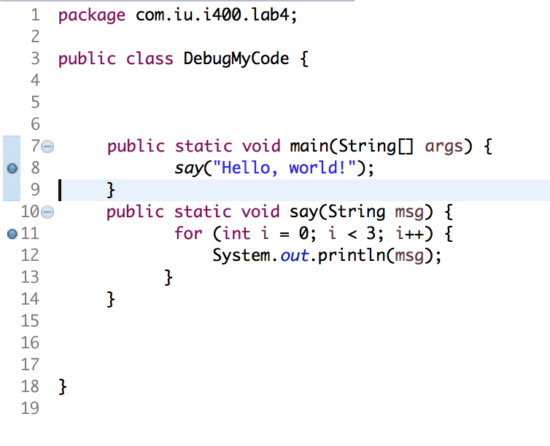
Breakpoints
Breakpoints are the points in the code which when setup lets the debugger suspend the code execution temporarily. You can choose these points.
How to place breakpoints?
Double Click on the left margin
of the line number to place these
Points
OR
Right-click in the left margin
in the Java editor and select
Toggle Breakpoint.
Two breakpoints:
Line 8
Line 11

Slide 7
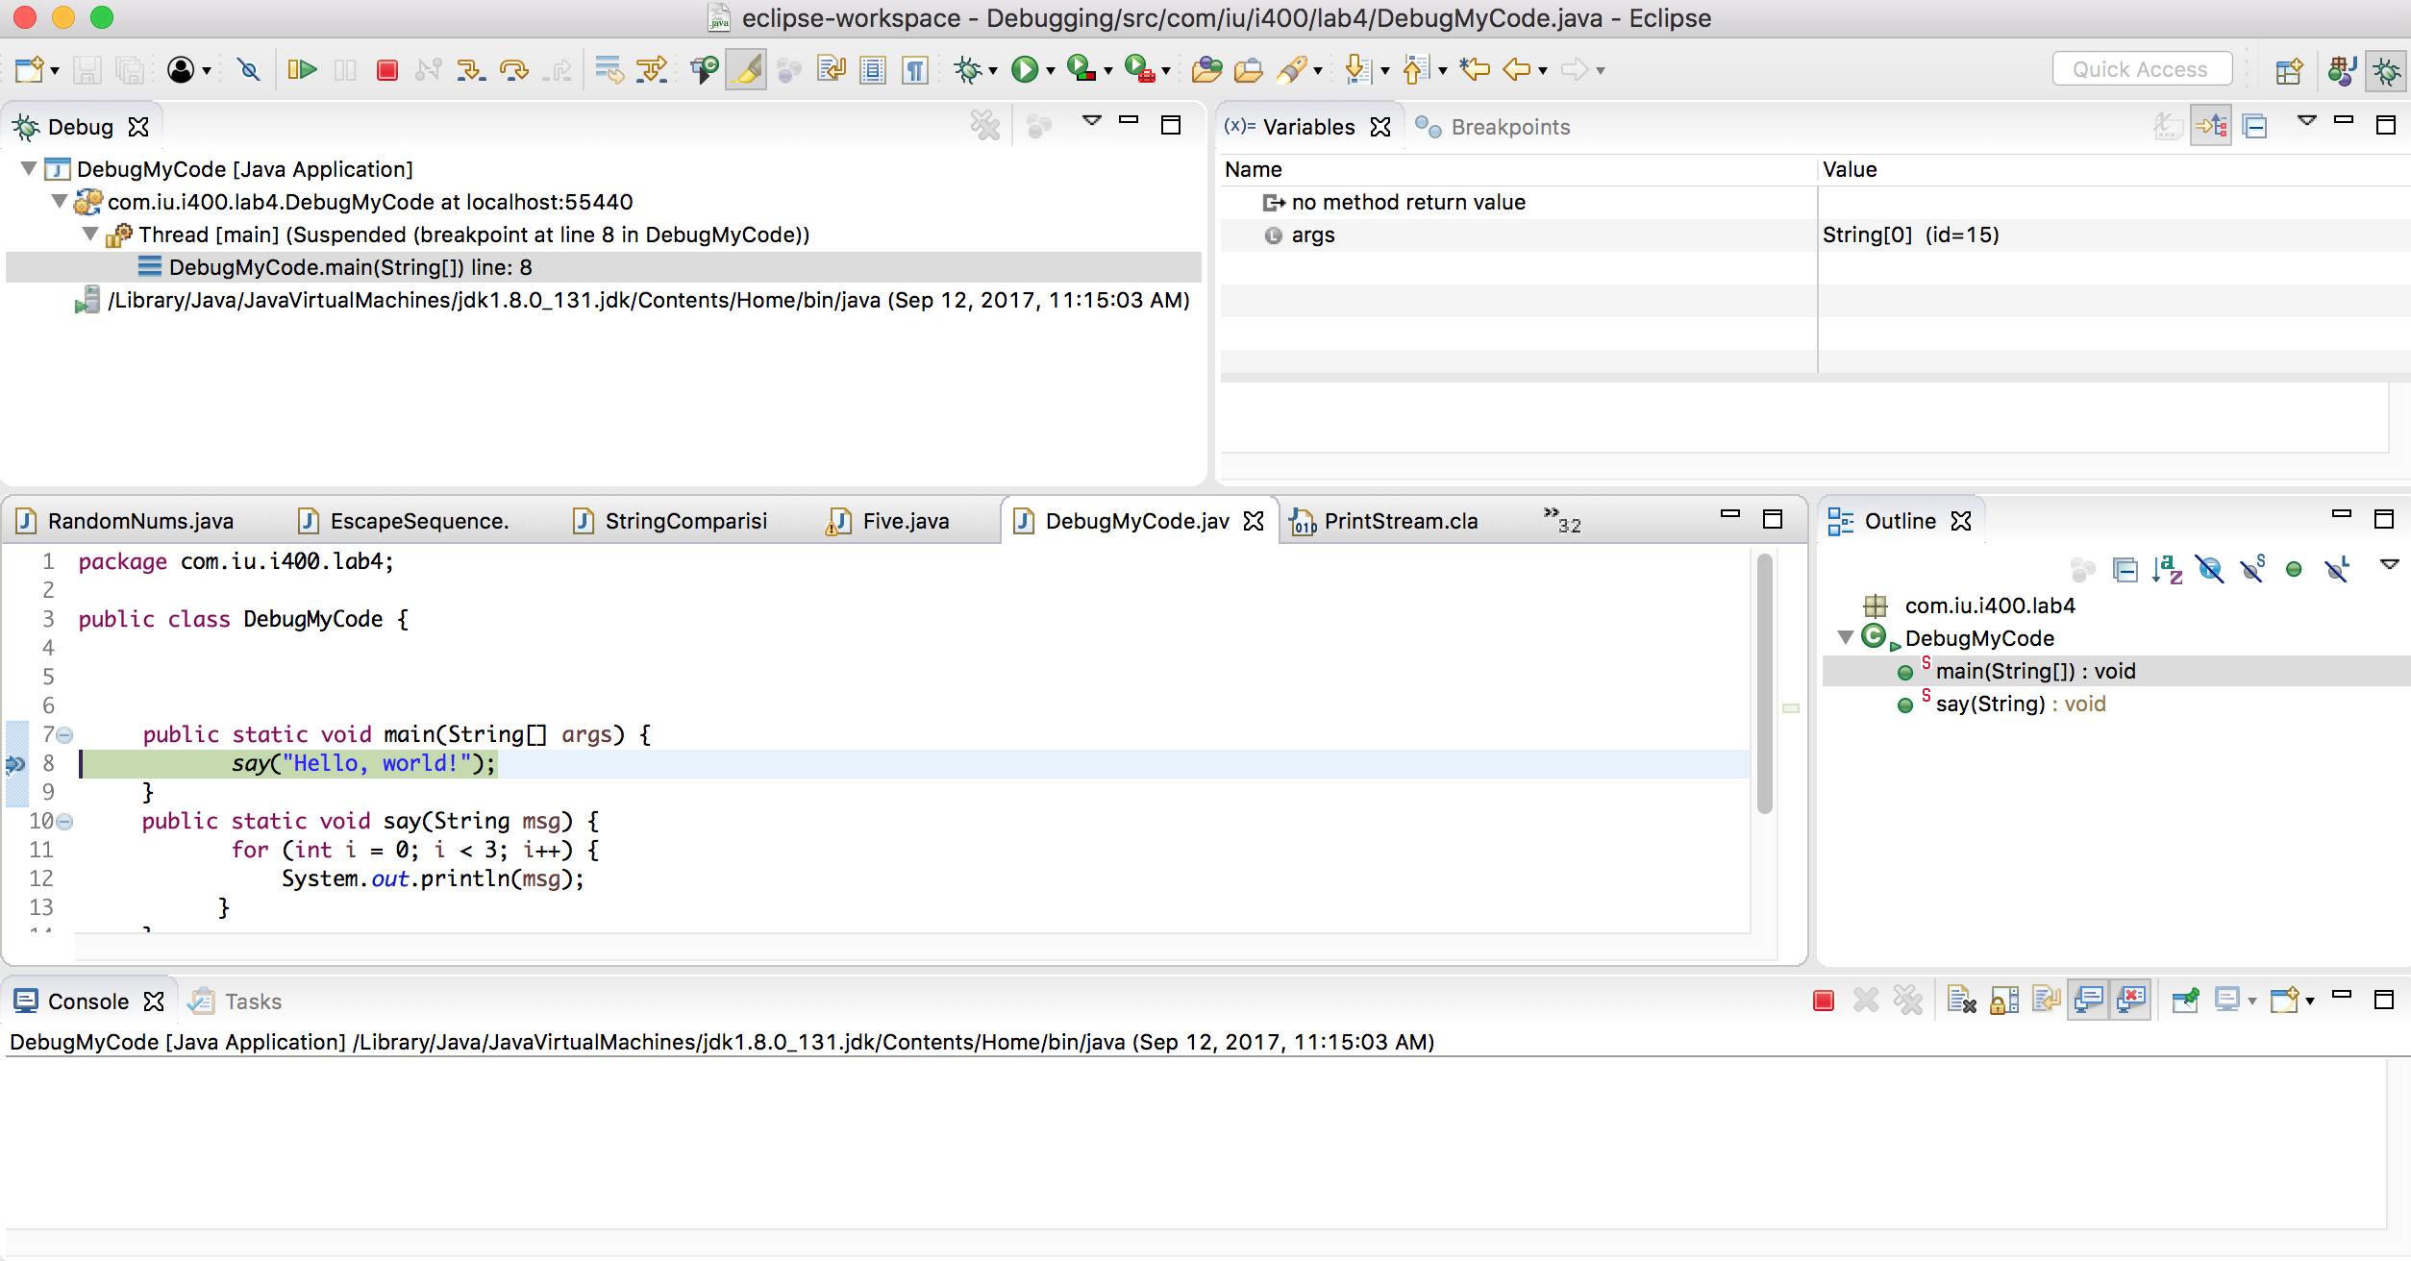
Debug Perspective
More about Debug Perspective
Debug Perspective Indicator
Debug View
1

Slide 8
Debug Perspective
More about Debug Perspective
Debug Perspective Indicator
2
2. Variables View

Slide 9
Debug Perspective
More about Debug Perspective
Debug Perspective Indicator
3
3. Breakpoints View

Slide 10
Debug Perspective
More about Debug Perspective
Debug Perspective Indicator
4. Display View
4

Slide 11
Debug Perspective
More about Debug Perspective
Debug Perspective Indicator
5. Console View
5

Slide 12
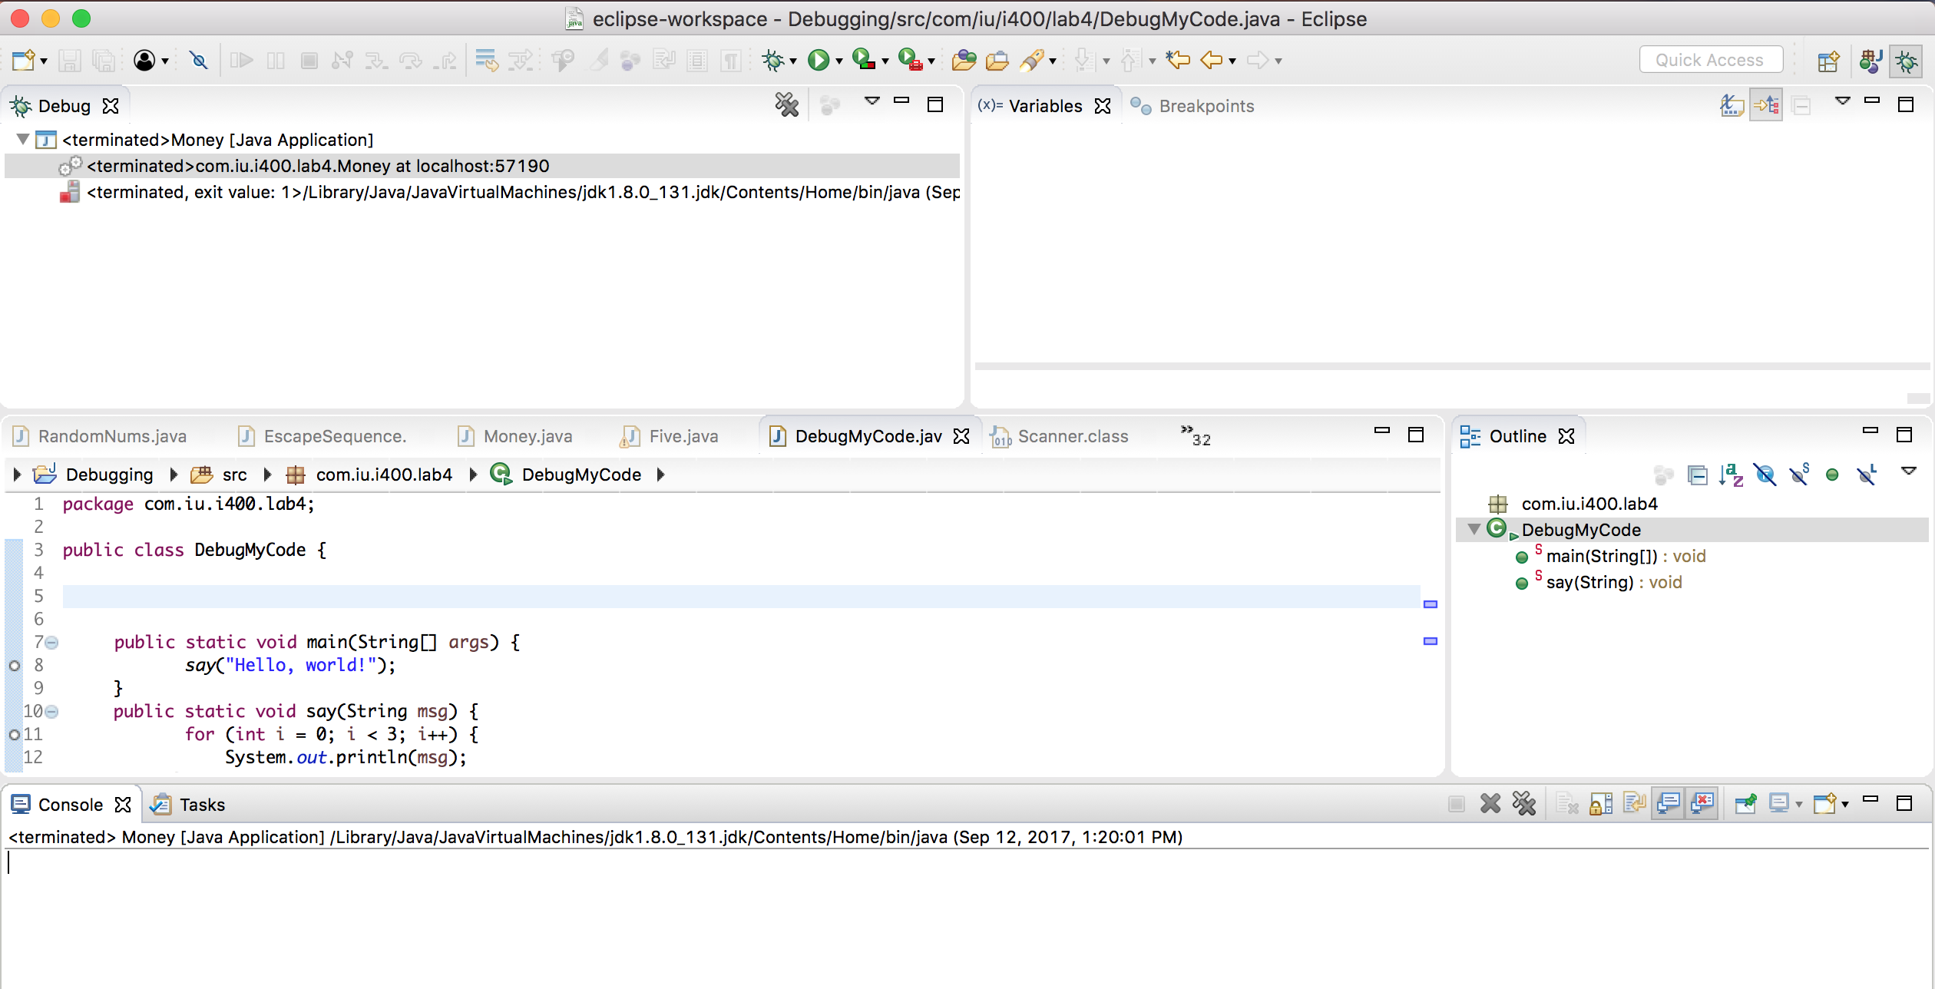
Switching Back to Java Perspective
Click on the highlighted icon to switch to Java Perspective

Slide 13
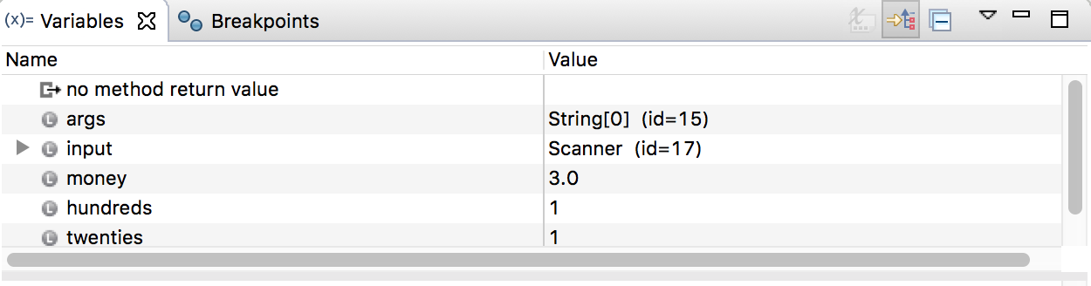
Variables View
Variables View: Shows the variables currently being used by the program while code is being executed

Slide 14
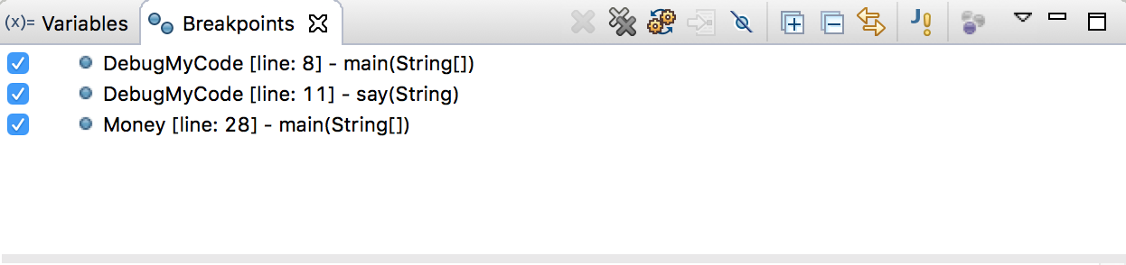
Breakpoints View
Breakpoints View: Shows all the breakpoints you have put in your workspace
Allows deleting and deactivating breakpoints

Slide 15






Stepping Commands
These commands help in controlling the execution of code.
Look for in the Toolbar
Shortcut | Toolbar | Description
F5 (Step Into) |  | Steps into the call
F6 (Step Over) |  | Steps over the call
F7 (Step Return) |  | Steps out of the caller
F8 (Resume) |  | Resumes Execution
Ctrl + R (Run to Line) |  | Run to the line number of current caret position
Ctrl + F2 (Terminate) |  | Terminate the execution process
More information about the differences between these here.

Slide 16
Additional Resources
Eclipse’s Beginner’s guide to Debugging:
http://www.eclipse.org/community/eclipse_newsletter/2017/june/article1.php
Another tutorial on Debugging in Eclipse:
http://www.vogella.com/tutorials/EclipseDebugging/article.html
A 15-minute video on Debugging in Eclipse:
https://www.youtube.com/watch?v=9gAjIQc4bPU

Slide 17

Code Fix: Challenge 1
You are given a class IAmBuggyStringReversal, where there are three bugs in the code. Use the built-in Eclipse debugging tools to determine what the errors are, then fix the code.
After you fix the code, it should take a String as an input and print the reverse of the string.

Slide 18
Code Fix: Challenge 2
A 3 digit Armstrong number is a number that is equal to the sum of cubes of its digits for example 153, 370, 371 etc.
Example: 153 = (1*1*1)+(5*5*5)+(3*3*3)
(1*1*1)=1
(5*5*5)=125
(3*3*3)=27
So: 1+125+27=153

Slide 19


…Challenge 2
Download IAmBuggyArmstrongNumber from Canvas. The code has three subtle bugs. Use the built-in Eclipse debugging tools to fix the issues.
The working code should have the following output.

Slide 20
Questions?

